Slide 1
IT Introduction

Slide 2
Mission Statement
Our mission is to provide an appropriate working environment for our users;
to Safeguard Corporate IT Assets; to Make Efficient, cost-effective use of IT resources

Slide 3

Access Security Policy
Physical entry controls
Management of individual assets
Security of documentation

Slide 4
Hardware & Software
Standard Software Configurations
Hardware: Dell/Lenovo Desktops/Laptops
Operating System: Windows 7
Word Processor: MS Office 365
Email Client: Outlook
Internet Browser: Internet Explorer/FireFox
Antivirus Client: Kaspersky Anti-Virus 10.0
Instant Messenger: Lync
E-Dictionary: 有道
Compression: 7zip
PDF viewer: Adobe PDF reader
Input method: Sogou Pinyin
Software Policy
ONLY Licensed and free software is allowed
P2P software is NOT allowed, excluding Skype
Streaming online video/audio software is NOT allowed

Slide 5
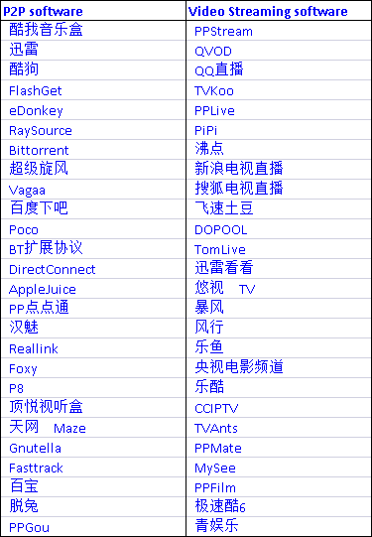
P2P software list

Slide 6
IT Security
Do
Follow the IT policies in the employee’s handbook
Contact IT immediately when you have any security issues
Do NOT
Do NOT follow any suspicious links on IM or in the Email
Do NOT open any mail or attachments from anonymous senders
Do NOT bring personal removable disks or laptops into office without permission
Do NOT install any illegal or cracked software

Slide 7
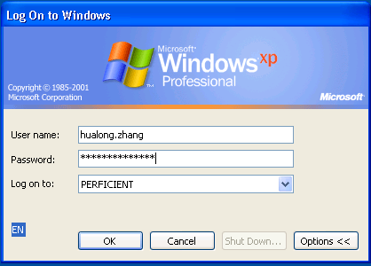
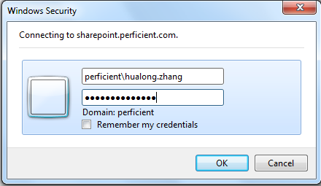
Accounts
Perficient LDAP & Active Directory accounts (for EBS, SharePoint, wiki…)

Slide 8
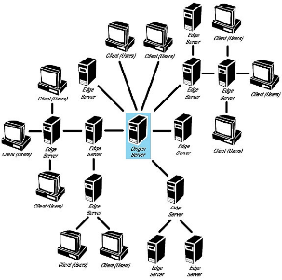
GDC Infrastructure - Servers
GDC Servers
Mail server: outlook.office365.com
File server: GDCDC01
Print server: GDCDC01
Antivirus Server:GDCSA01
Please do NOT shutdown your machines on every Monday night. There is a scheduled full disk scanning.

Slide 9
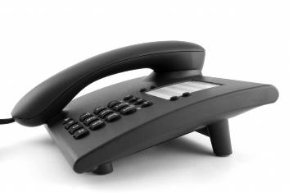
GDC Infrastructure - Phone
Phone Systems
Local phone for Backoffice:
Front desk Phone#: 5668-6690,
Fax#: 5668-6697
Domestic dialing only
Lync phone for meeting with US people:
Can be found in each meeting room
Dial US number directly
Cannot dial China number

Slide 10
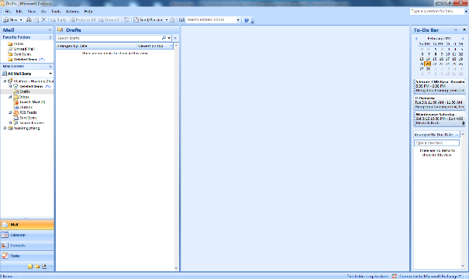
Perficient’s Online Resources - Email
Perficient is standardized on Microsoft Office365 and Outlook for it’s email. Employees can access their mail anytime by Outlook or Office365 Portal.
https://outlook.office365.com

Slide 11
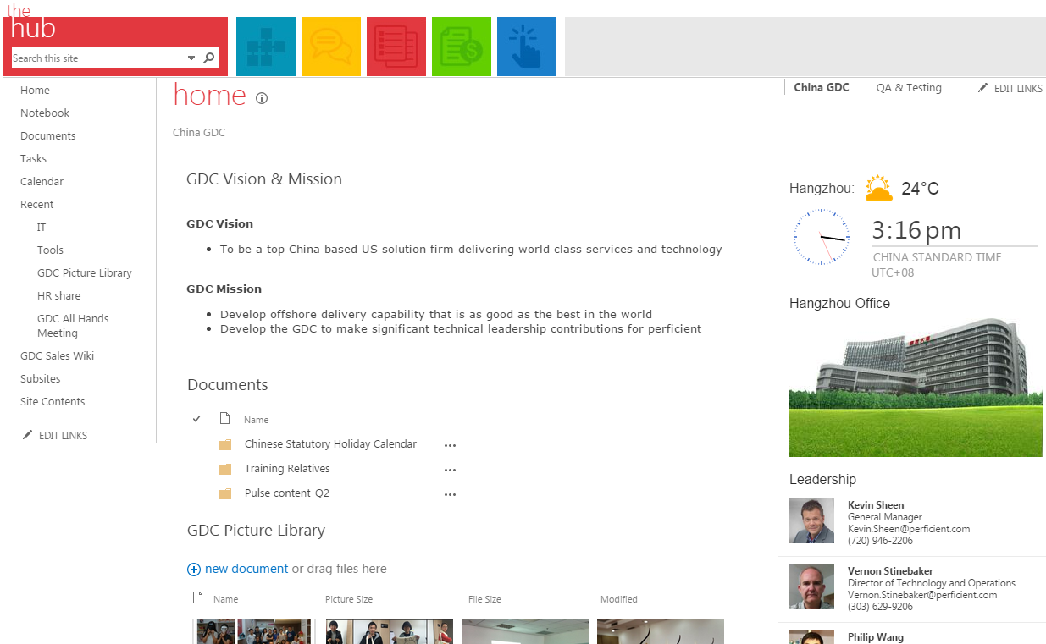
Perficient’s Online Resources – Hub
The GDC site on Perficient Hub is our intranet portal, which provides useful information to employee.
https://hub.perficient.com/bu/ChinaGDC

Slide 12
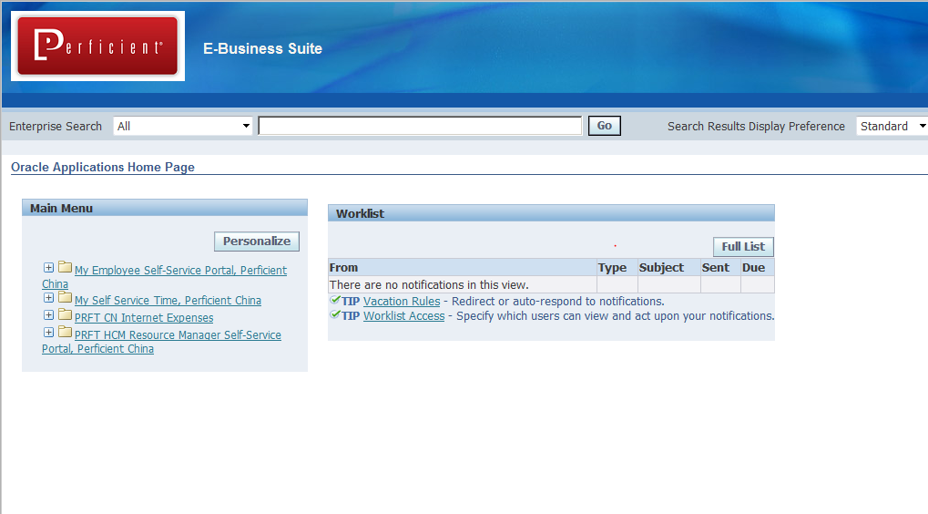
Perficient’s Online Resources – Oracle EBS
EBS is Perficient’s corporate resources planning system, which is used for collecting all time and expense entries.
https://ebs.perficient.com

Slide 13
Perficient’s Online Resources – MyPerficient
The my.perficient.com portal is Perficient’s corporate intranet for information sharing including:
Corporate & Strategic Business Unit (SBU) communications.
HR Benefits, career planning & new colleague information.
Operational information, calendars and various procedural documentation
Culture events and awards
https://hub.perficient.com

Slide 14
Perficient’s Online Resources – Wiki
The Perficient wiki is designed to be a collaborative environment where users contribute content and create value. The Wiki is used for things such as:
Collaborative project workspaces
Sharing SBU information
Establishing knowledge bases
https://wiki.perficient.com

Slide 15
Perficient’s Online Resources – Jira
Perficient has licensed the Enterprise version of the Jira bug tracking application. This version includes all available options, including: project dashboards, advanced notifications, process modeling and workflows.
Manage bugs, features, tasks, improvements or any issue
A clean and powerful user interface that is easy to understand for both business and technical users
Map your business processes to custom workflows
Track attachments, changes, components and versions
Full text searching and powerful filtering (customisable, saveable, shareable and subscribeable!)
Customizable dashboards and real-time statistics
Enterprise permissioning and security Easily extended to and integrated with other systems (including email, RSS, Excel, XML and source control)
Highly configurable notification options Web service enabled for programmatic control (SOAP, XML-RPC and REST interfaces)
https://jira.perficient.com

Slide 16
Perficient’s Online Resources – IT Support
Colleagues may contact the GDC IT team for any of the following supports needs:
Desktop, Laptop Break/Fix
Email Administration
Network Administration
Assets Management (procurement/new hire/inventory)
General Troubleshooting
Project Support
Phone: 6716
Email: servicedesk@perficient.com

Slide 17
Thank You !

